Slide 1

Operating Systems BCSC 0004
Concurrent Processes

Slide 2
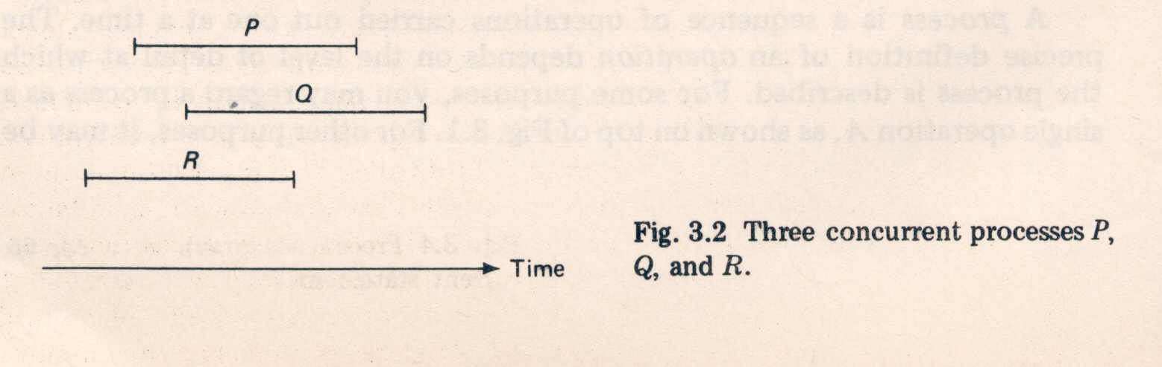
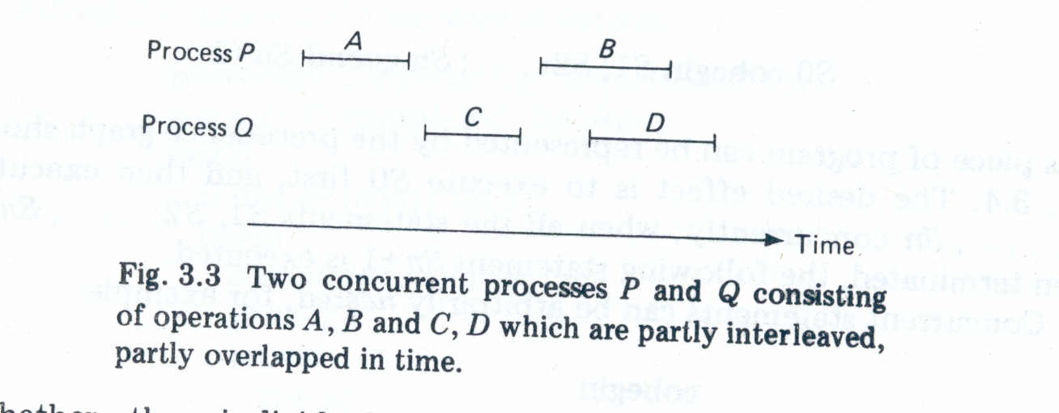
Concurrent Processes
Two processes are said to be concurrent if they over lap in their execution.

Slide 3
Representation
Precedence Graphs:
Consider the following program segment, which performs some simple arithmetic operations.
Program1 :
a : = x + y;
b : = z + 1;
c : = a – b;
w : = c + 1;

Slide 4
Precedence Graph
A precedence graph is a directed acyclic graph whose nodes correspond to individual statements. An edge form node S_{i} to node S_{j} means that statement S_{i} can be executed only after statement S_{i} has completed execution.
S₁
S₂
S₃
S₄
S₅
S₆
S₇

Slide 5
S₂ and S₃ can be executed after S₁ completes.
S₄ can be executed after S₂ completes.
S₅ and S₆ can be executed after S₄ completes.
S₇ can execute only after S_{5’} S_{6’} and S₃ complete.
Note that S₃ can be executed concurrently with S_{2’} S_{4’} S_{5’} and S_{6’}

Slide 6
Concurrency Conditions :
When can two statements in a program be executed concurrently and still produce the same results?
The following three conditions must be satisfied for two successive statements S₁ and S₂ to be executed concurrently and still produce the same result. It is known as Bernstein’s conditions.
R(S₁) ∩ W(S₂) = {}
W(S₁) ∩ R(S₂) = {}
W (S₁) ∩W(S₂) ={}
R(S_{I}) = {a_{1’} a_{2’} …’ a_{m}}’ the read set for S_{i ’} is the set of all variables whose values are reference in statement S_{i ‘} during its execution.
W(S_{i}) = {b_{1’} b_{2’} …’ b_{n}}’ the write set for S_{i ’} is the set of all variables whose values are changed (written) by the execution if statement S_{i ’}

Slide 7
Example :
S₁: a := x + y
S₂: b := z + 1
S_{3:} c := a – b
S1 and S2 statements can be executed concurrently because :
R(S₁) = {x, y}
R(S₂) = {z}
W(S₁) = {a}
W((S₂)= {b}
However, S₂ cannot be executed concurrently with, since
W(S₂) ∩ R(S₃) = {b}

